Slide 1

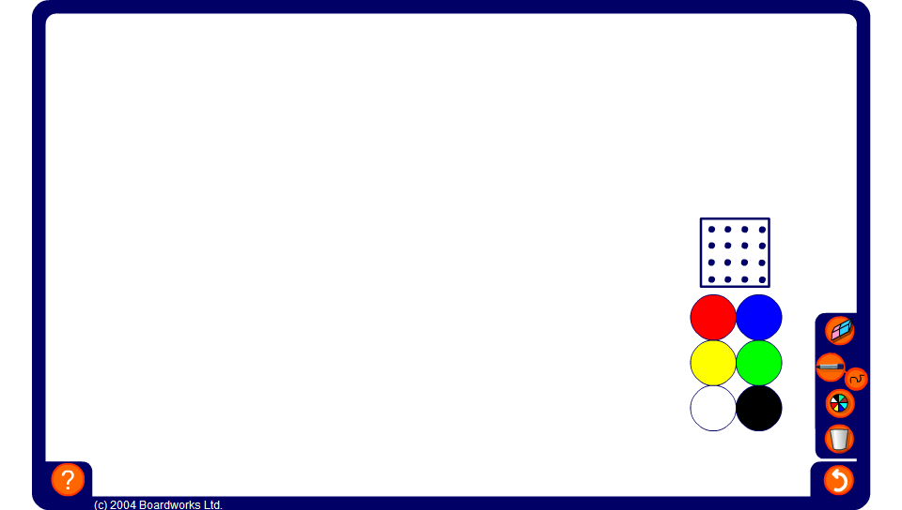


Making triangles
Notes:
Tell pupils that we can arrange counters into triangles by putting consecutive numbers of counters into rows.
For example, we can put one counter at the top, two counters in the next row and three counters in the third.
Demonstrate this arrangement using round counters on the board.
There are six counters in this arrangement. Six is a triangular number.
What is the next triangular number?
Show that we can find the next triangular number by adding a row of four counters.
The next triangular number is ten.

